Slide 1

A Comparative Study of QEMU and Microsoft Azure in Virtualization Technologies
MEMBERS: Cabanos, Rodel E. Cristobal, Dee Jay B De Guzman, Marie Joy W. Donato, Charles Bobby Q. Nicolas, Earl Ivan P. Rotugal, Jasmine L. Vergara, Justin Von T.

Slide 2

Introduction to Virtualization
What is Virtualization?
Why is it Important?
Creating software-based representations of computer resources (servers, storage, OS). Allows multiple virtual machines (VMs) on a single physical host, each independent, managed by a hypervisor.
Reduces IT expenses by maximizing hardware utilization.
Improves efficiency, scalability, and flexibility.
Enables faster deployment and enhanced portability.
Enhances security through isolation and snapshots.

Slide 3
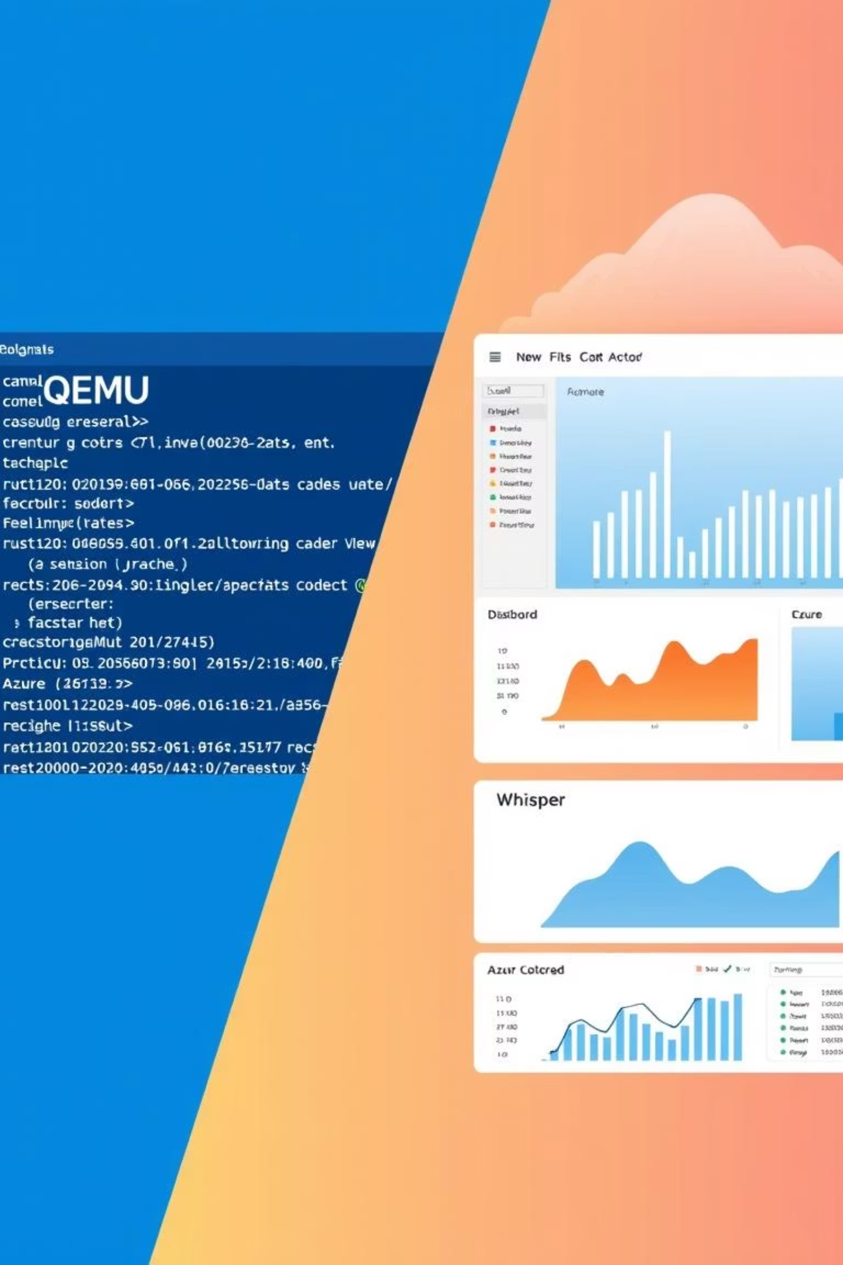
Overview of Virtual Platforms
QEMU Platform
Microsoft Azure Platform
Open-source machine emulator and virtualizer. Allows OS/apps to run across different hardware. Valued for flexibility, free use, and power. Primarily command-line based, supports diverse architectures (x86, ARM, RISC-V).
Cloud-based virtual machines hosted in Microsoft's global data centers. Offers scalable, managed resources through subscription. Integrated with cloud services, with Microsoft managing security and scalability.
Strengths: Scalability, high availability, reduced hardware management, strong security.
Strengths: Open-source, cost-free, architecture-flexible, offline use.
Limitations: Steep learning curve, resource-intensive, command-line reliance.
Limitations: Recurring expenses, internet dependency, user responsibility for OS.

Slide 4
Comparative Analysis & Case Studies
VM Creation
CLI-based; technical setup.
Cloud-based; easy portal/CLI.
Cost
Free, open-source.
Pay-as-you-go.
OS Compatibility
Many OSes (x86, ARM, RISC-V).
Windows/Linux (x86/x64).
QEMU Case Study: University Department
Azure Case Study: Finova
Adopted QEMU for OS/Embedded Systems teaching, saving 70% costs by simulating hardware. Enabled students to run experiments on personal laptops, improving safety and learning.
Used Azure VMs for dev/testing, reducing costs by 70% with Spot VMs and automation. Maintained 98.5% reliability, improving scalability and operational efficiency.

Slide 5
Conclusion & Recommendations
QEMU and Azure serve distinct purposes in virtualization. QEMU is ideal for personal use, learning, and experimentation, being free and local. Azure VMs are suited for organizations and enterprises needing scalability, reliability, and advanced cloud resources.
1
2
3
Students & Beginners
Educational Institutions
Businesses & Organizations
Use QEMU for hands-on OS and networking experience.
Combine QEMU for local practice and Azure for scalable online labs.
Invest in Azure VMs for critical applications and cloud infrastructure.
4
5
Researchers & Developers
Cost Management
Use Azure for heavy computations, QEMU for local testing.
Implement monitoring for Azure VM usage to optimize expenses.

